Slide 1


FINAL DESIGN REVIEW
MET2001 System Engineering Project 1
Trimester 3, Academic Year 23/24
Group 4:
Bellamy Woo (2301579)
Muhd Ariff (2301644)
Shaun Ong (2301632)
Chai Ze Xuan (2301629)
Low Min Wei (2301555)

Slide 2


CONTENT
FINAL DESIGN CONFIGURATION
FINAL SYSTEM SPECIFICATIONS
TESTING RESULT / PROTOTYPE EVIDENCE
KEY LEARNING POINTS AND ACHIEVEMENTS

Slide 3
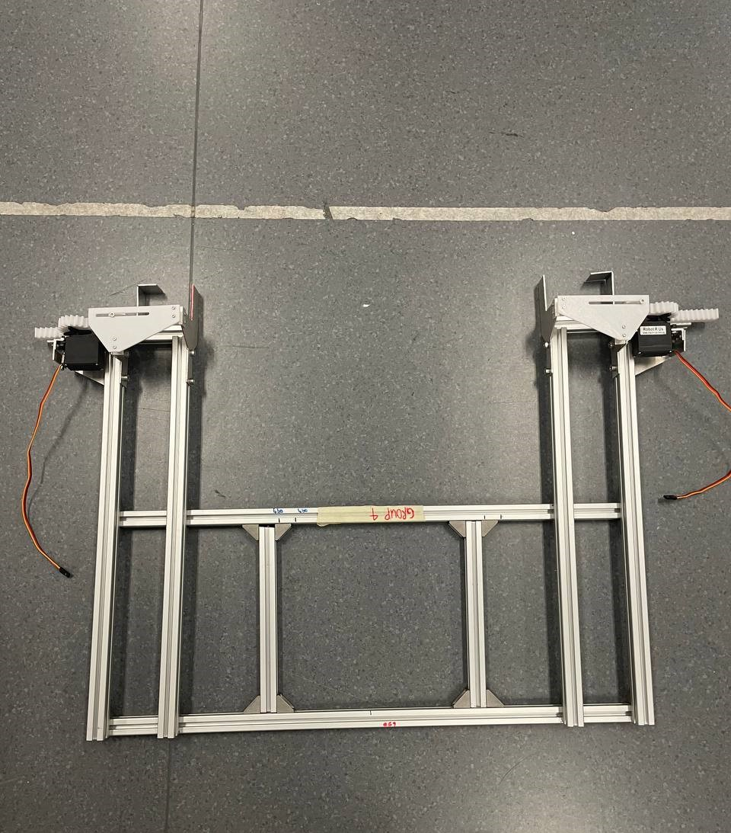
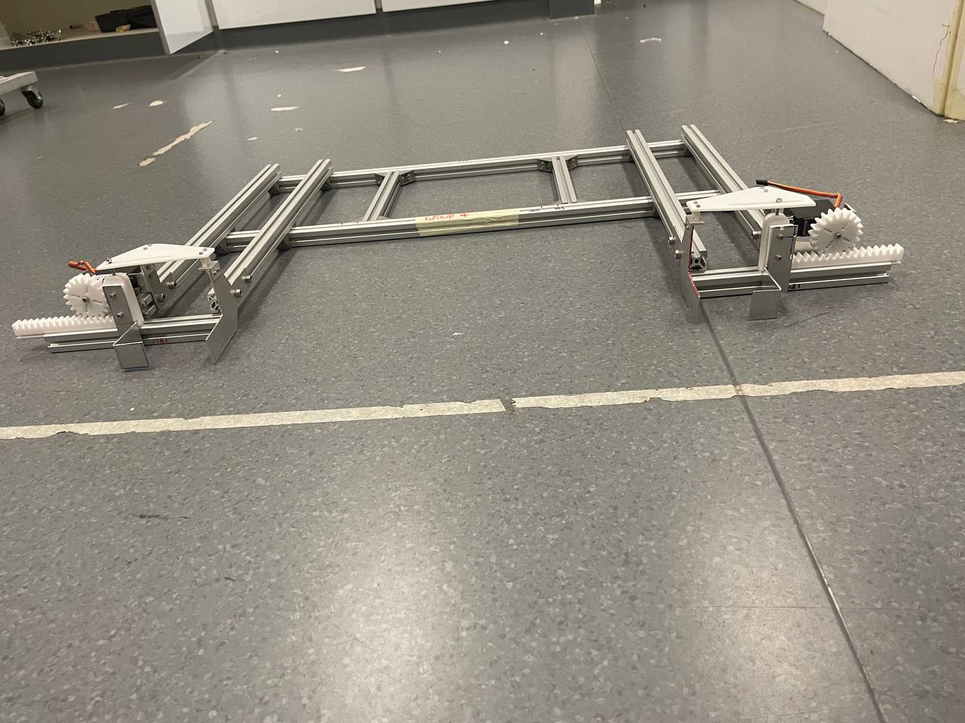
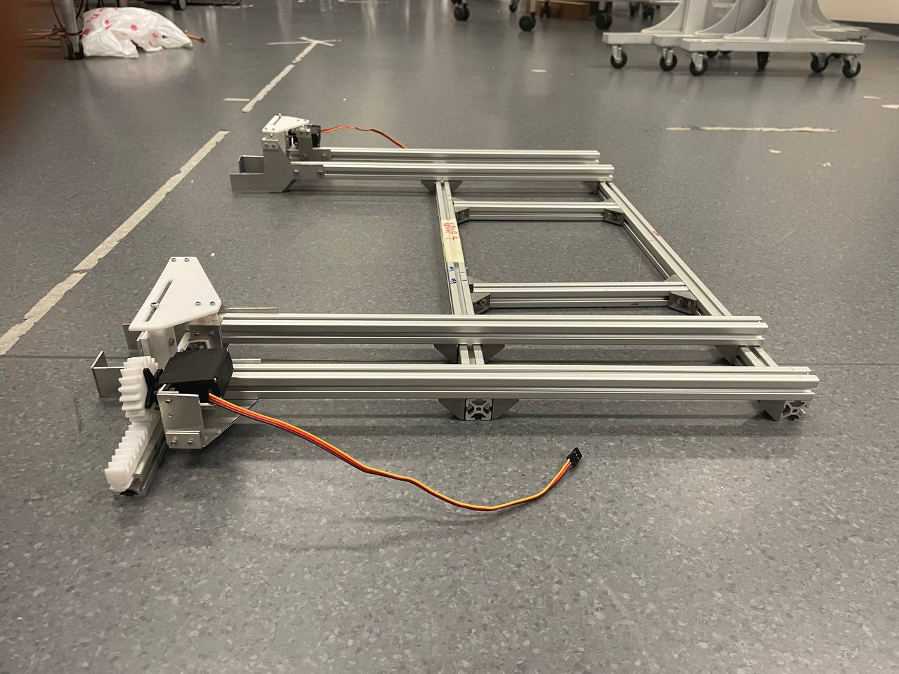
FINAL DESIGN CONFIGURATION
Top View
Front View
Side View

Slide 4
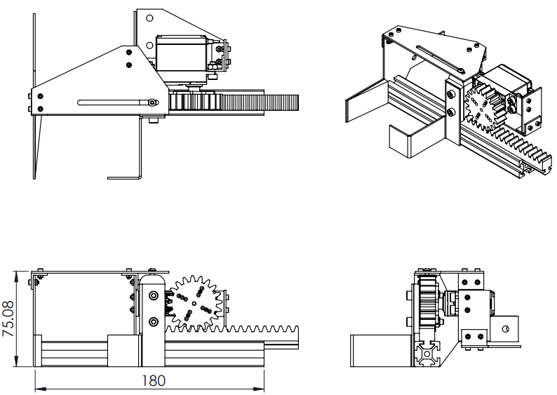
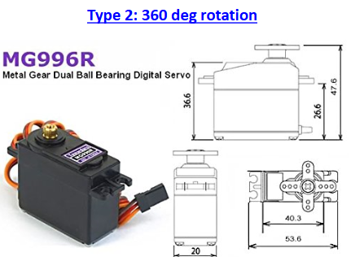
FINAL SYSTEM SPECIFICATIONS
Rack and Pinion
Weight: 2.5Kg
Dimension: 75.08 x 180 x 130mm
Gear Module: 2
Gear Pitch Diameter: 40mm
Number of teeth of Gear: 20
TowerPro MG996R Servo Motor (x2)
Weight: 55g
Dimension: 40.7 x 19.7 x 42.9mm
Stall Torque: 9.4Kg/cm (4.8V); 11Kg/cm (6.0V)
Operating Speed: 0.19sec/60 degree (4.8V); 0.15sec/60 degree (6.0V)
Operating Voltage: 4.8V - 6.6V
Gear Type: Metal Gear
Temperature Range: 0 - 55 degree Celsius
360-degree travel

Slide 5
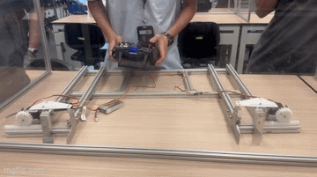
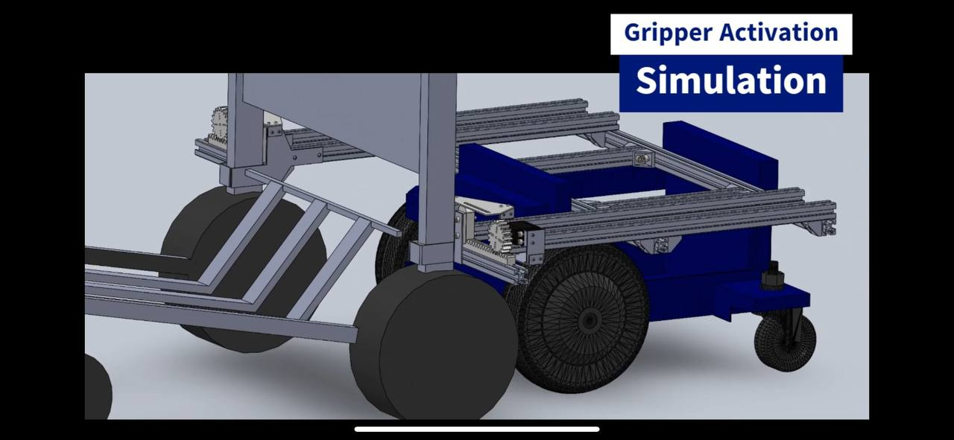
TESTING RESULT / PROTOTYPE EVIDENCE
Gripper Movement
Gripper Functionality Test

Slide 6
KEY LEARNING POINTS AND ACHIEVEMENTS
Key Learning Points
Time management Skills
Improvement to machining and fabrication skills
Importance of weight distribution
Creation of modular design
Selection of proper gripper mechanism and mechanical actuator
Achievements
Fabricated finalised gripper design
Completed simple testing of gripper and supporting frame
Successful mounting on AMR

